Slide 1
Assembly Language Programming Group Presentation
ADVANCED MASM PROCEDURE DIRECTIVES
Group Members
Bilen Tewodros…..………...….RCS/029/22
Melaku Melesa………………RCS/089/22
Nahom Befekadu……………RCS/103/22
Natnael Abyot……………….RCS/106/22
Ramzi Mohammed………….RCS/113/22
Redieat Feleke…..………...…..RCS/115/22
Harmod Sahle...........................RCS /1429/23

Slide 2
Advanced MASM Procedure Directives
INVOKE, PROC, PROTO, and ADDR are advanced MASM directives.
They are available in 32-bit mode only.
They simplify procedure definition and invocation.
They provide features similar to high-level languages.
Their use can hide low-level stack behavior.

Slide 3
Motivation for Using These Directives
Manual stack handling is error-prone.
Multiple PUSH instructions reduce readability.
Advanced directives improve code clarity.
They are especially useful in large programs.
Cross-module calls benefit from validation.

Slide 4
The INVOKE Directive
The INVOKE directive, only available in 32-bit mode, pushes arguments on the stack (in the order specified by the MODEL directive’s language specifier) and calls a procedure.
INVOKE is a convenient replacement for the CALL instruction because it lets you pass multiple arguments using a single line of code.
Automatically pushes arguments onto the stack.
Argument order depends on the calling convention.
Supports passing many arguments.
Reduces repetitive assembly code.

Slide 5
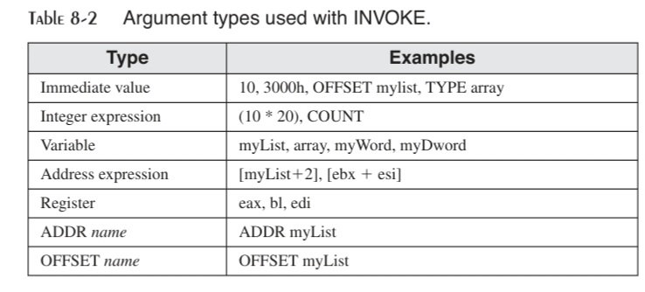
INVOKE Syntax and Rules
General syntax: INVOKE procedureName [, argumentList].
ArgumentList is an optional comma-delimited list of arguments passed to the procedure.
INVOKE permits almost any number of arguments, and individual arguments can appear on separate source code lines.

Slide 6
INVOKE Example
Traditional method uses PUSH instructions.
Each argument must be pushed manually.
CALL instruction transfers control.
INVOKE combines all steps into one line.
Example: INVOKE DumpArray, OFFSET array, LENGTHOF array, TYPE array.
EAX, EDX Overwritten: If we pass arguments smaller than 32 bits to a procedure, INVOKE frequently causes the assembler to overwrite EAX and EDX when it widens the arguments before pushing them on the stack. This behavior can be avoided by always passing 32-bit arguments to INVOKE, or we can save and restore EAX and EDX before and after the procedure call.

Slide 7
The ADDR Operator
The ADDR operator, also available in 32-bit mode, can be used to pass a pointer argument when calling a procedure using INVOKE. It simplifies pointer argument passing.
ADDR can only be used with INVOKE.
The argument passed to ADDR must be an assembly time constant. The following is an error:
INVOKE mySub, ADDR [ebp+12]; error
Invalid with runtime expressions.

Slide 8
ADDR Example
Used when procedures expect pointer parameters.
Example: INVOKE FillArray, ADDR myArray.
Assembler generates PUSH OFFSET myArray.
Improves readability over OFFSET usage.
Not allowed in MOV or other instructions.

Slide 9
The PROC Directive
PROC defines a procedure block.
In 32-bit mode, the PROC directive has the following basic syntax:
label PROC [attributes] [USES reglist], parameter_list
Attributes refers to any of the following:
[distance] [langtype] [visibility] [prologuearg]
It declares parameters and attributes.
Automatically generates prologue code.
EBP is used to access parameters.
Simplifies stack frame creation.

Slide 10
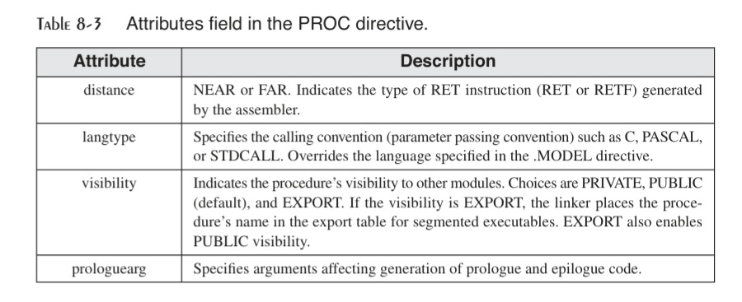
PROC Parameter Lists
The PROC directive permits you to declare a procedure with a comma-separated list of named parameters. Your implementation code can refer to the parameters by name rather than by calculated stack offsets such as [ebp + 8]:
Type can be one of the following: BYTE, SBYTE, WORD, SWORD, DWORD, SDWORD, FWORD, QWORD, or TBYTE. E.g. MySub PROC param1:DWORD
Qualified types: PTR BYTE, PTR SBYTE, PTR WORD, etc E.g. MySub PROC pArray:PTR DWORD
Parameters are local to the procedure.
Names replace manual EBP offset calculations.
Improves maintainability and readability.

Slide 11
PROC Example: AddTwo
Example:
AddTwo PROC,
val1:DWORD, val2:DWORD
mov eax,val1 add eax,val2
Ret
Add Two ENDP
Parameters are accessed by name.
EAX stores the return value.
MASM generates stack setup and cleanup.
RET instruction cleans parameters automatically.

Slide 12
The USES Clause
USES specifies registers to preserve.
The MASM-generated code for Read_File shows how space is reserved on the stack for the local variable (fileHandle) before pushing EAX and EBX (specified in the USES clause):
Read_File PROC USES eax ebx LOCAL fileHandle:DWORD ; ... Procedure body ... Ret Read_File ENDP
Registers are pushed automatically.
They are restored before procedure return.
Reduces programmer errors.
Improves procedure reliability.

Slide 13
The PROTO Directive
In 64-bit mode, we use the PROTO directive to identify a procedure that is external to the program.
In 32-bit mode, however, PROTO is more powerful because it can include a list of Procedure parameters. The PROTO directive creates a prototype for an existing procedure.
A prototype declares a procedure’s name and parameter list. It allows us to call a procedure before defining it and to verify that the number and types of arguments match the procedure Definition.
Required when using INVOKE.
Specifies parameter list and types.
MASM requires a prototype for each procedure called by INVOKE. PROTO must appear
First before INVOKE.
Improves modular programming.

Slide 14
The PROTO Directive
Standard Ordering of Directives: MySub PROTO ; procedure prototype
INVOKE MySub ; procedure call MySub PROC ; procedure implementation MySub ENDP
Example: ArraySum PROTO,
ptrArray:PTR DWORD, ; points to the array
szArray:DWORD ; array size

Slide 15
Assembly-Time Argument Checking
The PROTO directive helps the assembler compare a list of arguments in a procedure call to the procedure’s definition. The error checking is not as precise as in languages like C and C++.
MASM checks for the correct number of parameters, and to a limited extent, matches argument types to parameter types.
Detects too few or too many parameters.
Performs limited type checking.
Some mismatches are not detected.
Helps catch errors early.

Slide 16
Summary
INVOKE simplifies procedure calls.
ADDR improves pointer passing.
PROC structures procedure definitions.
PROTO enables safer procedure calls.
Advanced directives improve program quality.

